Slide 1

Using Non-Domain Contrastive Data to improve Medical Question Answering

Slide 2
Introduction
In recent years, we have seen vast improvements in the performance of large language models in a variety of tasks and domains.
Reliable question answering can be hugely beneficial in alleviating scarcity of healthcare professionals
As with many specific machine learning tasks, there is a shortage of organized, expert-verified data to train models.

Slide 3
Contrastive Instance Bundles
Machine learning models are typically trained with the assumption that the training instances sampled from some data distribution are independent, leading to lower performance on minimally different questions.
Training with instance bundles allows models to contrast similar questions to avoid learning patterns unrelated to semantic meaning
Original Question: Is pain experienced in a missing body part or paralyzed area?
Label: yes
Perturbed Question: Is pain experienced in organs that are not physically part of the body?
Label: yes
Perturbed Question: Is pain experienced only with spinal cord injury?
Label: no

Slide 4
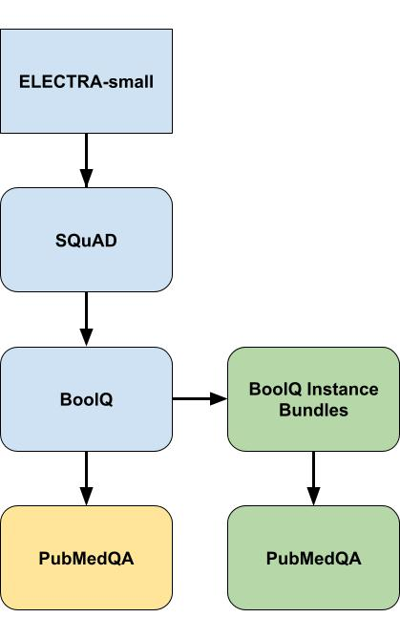
Experiment
Can we achieve greater performance on biomedical question answering tasks by training the question answering model with not only domain specific question/answer examples, but also contrastive examples?
Experiment steps:
1) Pretrain on SQuAD
2) Add classification head, fine-tune on BoolQ for yes/no output
3) One model trains on BoolQ instance bundles before PubMed, other model trains directly on PubMed
4) Compare results

Slide 5
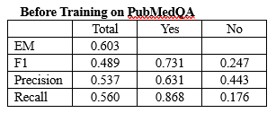
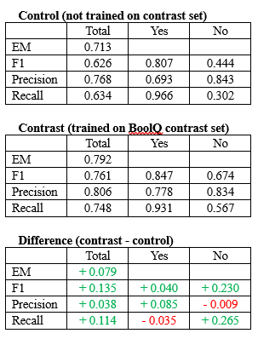
Results (Metrics)
Instance bundles caused notable improvement in nearly every metric.
Especially large increases in the F1 and recall scores for ‘no’ when compared to the model that wasn’t trained on the contrast set.
Effective at decreasing false negatives.
Since the contrast dataset has a nearly 50-50 split of yes/no labels, it can be reasonably inferred that this decrease in false negatives for no is not due to the model learning the distribution of class labels.

Slide 6
Results (examples)
Contrast model performed much better on examples with modifiers that suggest a positive response, but had a ‘no’ label:
Handling of certain scientific terms like "significant difference" and "statistically significant“ was better with the contrast model, especially with negative connotation.
Contrast model handled questions relating to study results better, especially when portions of the study exhibited positive results but the portion in question did not.
Question: Does successful completion of the Perinatal Education Programme result in improved obstetric practice?
Label: no
Original Question: Is the clinically positive axilla in breast cancer really a contraindication to sentinel lymph node biopsy?
Context: Clinically positive axillary nodes are widely considered a contraindication to sentinel lymph node (SLN) biopsy in breast cancer, yet no data support this mandate.
Label: no

Slide 7
Conclusion
Pre-training the model on the contrast dataset seemed to allowed it to reason better in a variety of different ways and made a difference in the accuracy of the model, despite it being a fraction of the examples.
Perhaps with a larger training set, benefits from small perturbed set could be drowned out.
This helps to demonstrate that there are several ways to improve technical, domain focused language models without the use of in-domain examples.

